Slide 1

PYTHON
NUMBERS

Slide 2

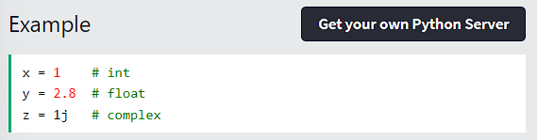
PYTHON NUMBERS
Python Numbers
There are three numeric types in Python: int
float complex
Variables of numeric types are created when you assign a value to them:
Python - Numbers

Slide 3
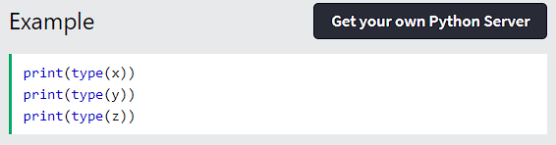
PYTHON NUMBERS
To verify the type of any object in Python, use the type() function:
Python - Numbers

Slide 4
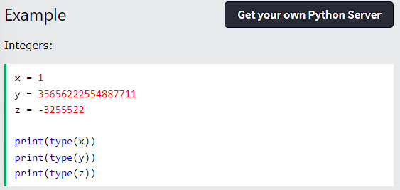
PYTHON NUMBERS
Int
Int, or integer, is a whole number, positive or negative, without decimals, of unlimited length.
Python - Numbers

Slide 5
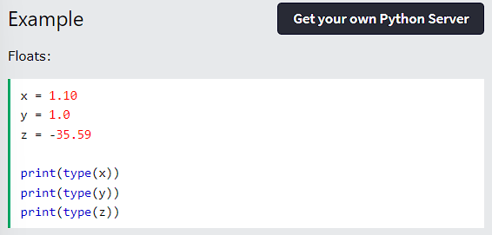
PYTHON NUMBERS
Float
Float, or "floating point number" is a number, positive or negative, containing one or more decimals.
Python - Numbers

Slide 6
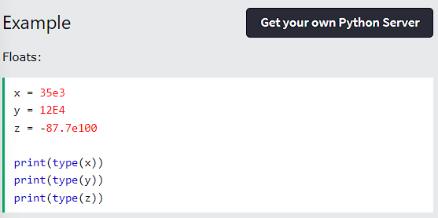
PYTHON NUMBERS
Float can also be scientific numbers with an "e" to indicate the power of 10.
Python - Numbers

Slide 7
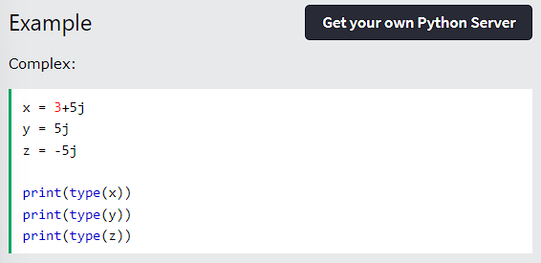
PYTHON NUMBERS
Complex
Complex numbers are written with a "j" as the imaginary part:
Python - Numbers

Slide 8
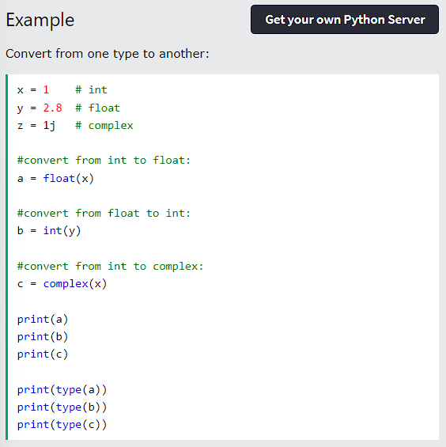
PYTHON NUMBERS
Type Conversion
You can convert from one type to another with the int(), float(), and complex() methods:
Python - Numbers

Slide 9
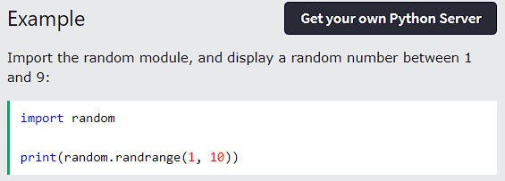
PYTHON NUMBERS
Random Number
Python does not have a random() function to make a random number, but Python has a built-in module called random that can be used to make random numbers:
Python - Numbers

Slide 10
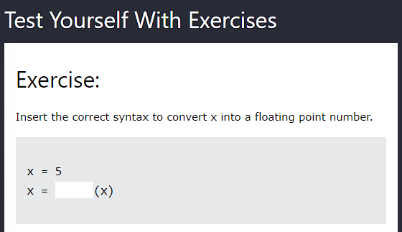
PYTHON NUMBERS
Python - Numbers

Slide 11
THANK YOU

